Slide 1
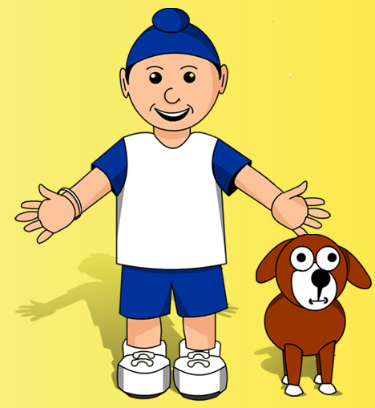
Achint’s Diwali
SAMPLE

Slide 2

It had been a long and thrilling few days for Achint, each day waking up more and
more excited!
Whilst his Hindu friends had been eagerly awaiting Diwali, Achint, as a Sikh, had
the extra excitement of Bandi Chorh Diwas first!
SAMPLE

Slide 3
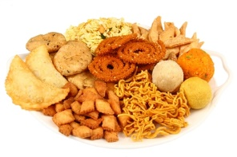
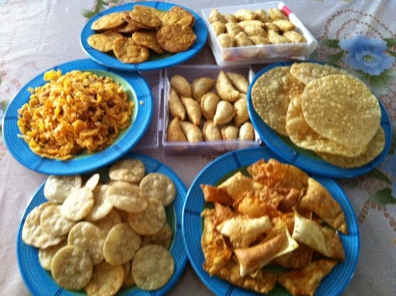
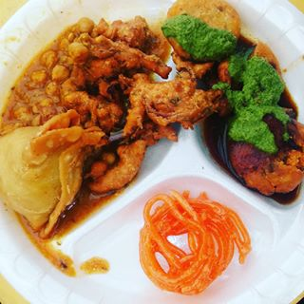
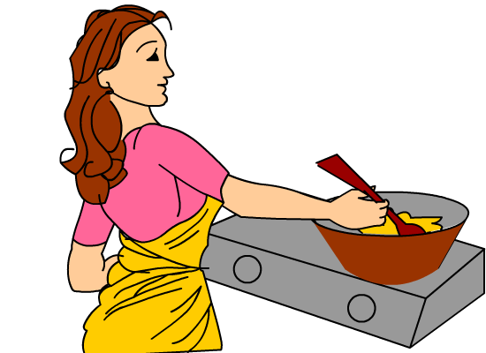

His mouth watered thinking about the feast of flavours which had been set up, to celebrate the wondrous occasion.
SAMPLE

Slide 4
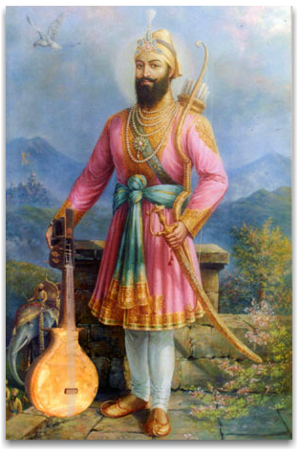
As he got undressed, Achint looked thoughtfully at the new clothes that his Maa (Mum) had bought for the festival, and that he had been eagerly waiting to put on. They reminded him suddenly of the Guru. Without him and his courage, this festival, and Diwali after, would never be remembered by Sikhs.
Bandi Chorh Diwas (Prisoner Liberation Day) was a really special time because it celebrated the release from prison of the clever sixth guru, Guru Hargobind, and 52 other princes with him, in 1619.
SAMPLE

Slide 5
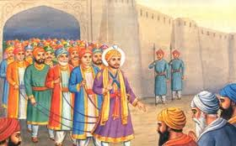
Guru Hargobind had been held prisoner, along with many others, even though they were innocent! After many years in prison, Emperor Jahangir finally agreed to release him. The Guru asked that the rajas and princes be freed also. The Emperor agreed, but said that only those who could hold onto his coat tail would be allowed to leave the prison (he didn’t really want anyone to go free and thought this would stop them!). However, Guru Hargobind had a coat made with 52 coat tails, and so each prince was able to hold onto one string and leave prison!
SAMPLE

Slide 6
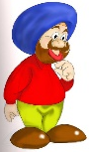
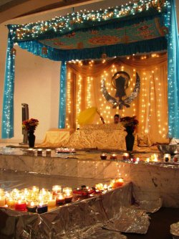
Achint knew that Diwali (originally a Hindu festival) was being celebrated on the day when the Guru reached the Golden Temple, and that on his arrival the people lit up the whole city with thousands of candles, lights and lamps in celebration and joy. Since then, Diwali had taken on a new meaning for Sikhs and was celebrated all around the world to remember this!
Achint had enjoyed remembering this by carefully carrying his very own candle to place before the Guru, while his older brothers and sisters lit their candles one from the other. However, he had been most excited about watching the wonderful displays of fireworks which Pita (his father) had helped prepare specially for the celebrations.
SAMPLE

Slide 7


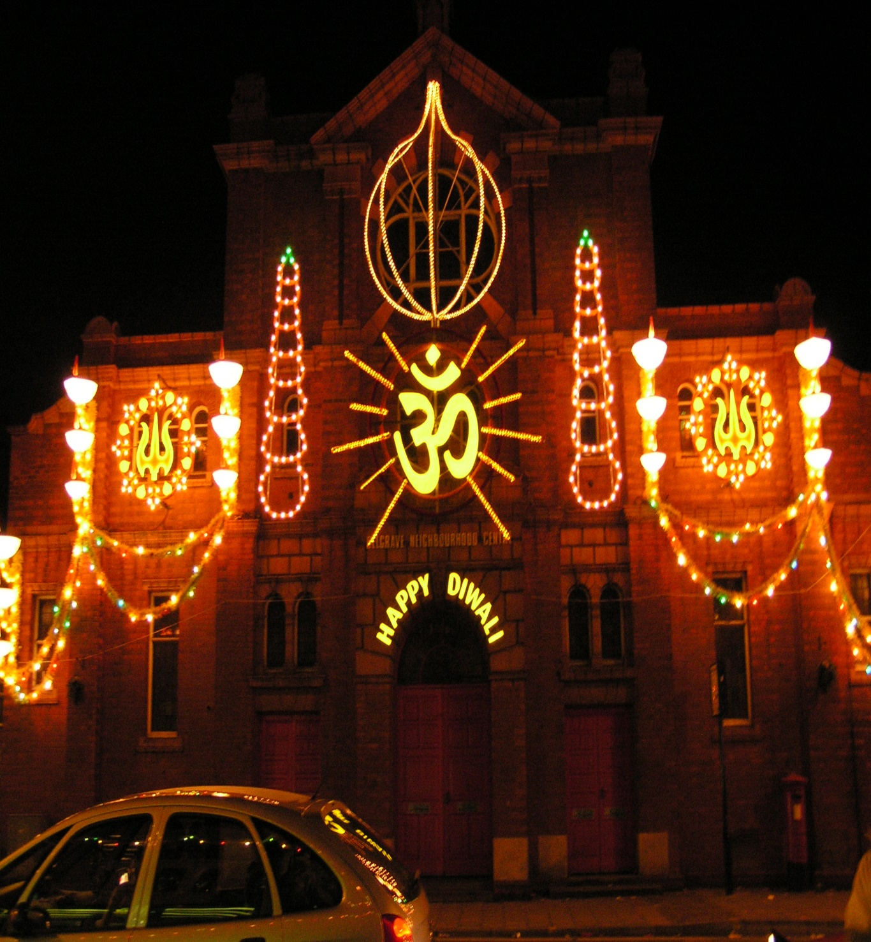

As Achint had walked to the Gurudwara, his brother and sister had chatted about what it would look like; How many lights would there be? Would there be even more decorations than last year?
When he had finally arrived it had been so brightly lit with coloured lights, that Achint thought it might be possible to see it from the moon!
SAMPLE

Slide 8
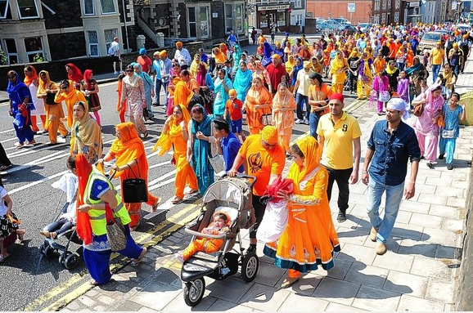
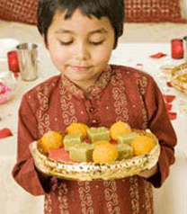
Achint enjoyed the daylong celebrations which took place in his Gurudwara. Although he knew that the nonstop reading of the special book called the Guru Granth Sahib and the singing of the Gurbani Kirtan (hymns) and prayers were important parts of the celebrations, it was the offerings of both money and gifts, like flowers and sweets, and the Nagar Keertan (street procession) which he had been more interested in seeing. Achint’s Maa had told him they had these yummy sweets to remember how the Guru's Mother was so happy when he was freed that she ordered food and sweets and gave them to everyone.
SAMPLE
https://www.youtube.com/watch?v=g2kAs6hgcjQ

Slide 9
With a huge yawn, Achint slowly got into bed. It had been the best Bandi Chorh Diwas and Diwali that he had ever had and he was looking forward to re-living it tonight in his dreams!
z
SAMPLE
z
z
z
z

